Slide 1
CuPBoP: CUDA for Parallelized and Broad-range Processors
Chihyo(Mark) Ahn
Notes:
Hello everyone, My name is Mark, and It’s my pleasure to have this opportunity to introduce CupBoP , our in-house framework to execute CUDA on non Nvidia devices. And this presentation will be mainly about how we can make cuda source code executable in vortex, using this framework.

Slide 2
Agenda
Related works
CuPBoP workflow
CuPBoP Runtime Functions
Compilation
How to Run CuPBoP
Code Structure
Step-by-step Tutorial
Supporting Benchmarks
Notes:
and here's the outline of this presentation. I’ll start with introducing other works that aims supporting cuda on non-nvidia devices and explain how CuPBoP is different in terms of the approach. And then go over the the framework to see how we actually use the framework to execute CUDA source code in Vortex.

Slide 3
Motivation
Notes:
So, let’s begin with the motivation.

Slide 4




CUDA is popular for HPC
Software
Hardware
Notes:
Why did we start this work? There are different programming languages for parallel execution. And for High Performance Computing, CUDA is one of the most popular choice for data-parallel computation compared to other langages, such as OpenCL or SyCL.

Slide 5
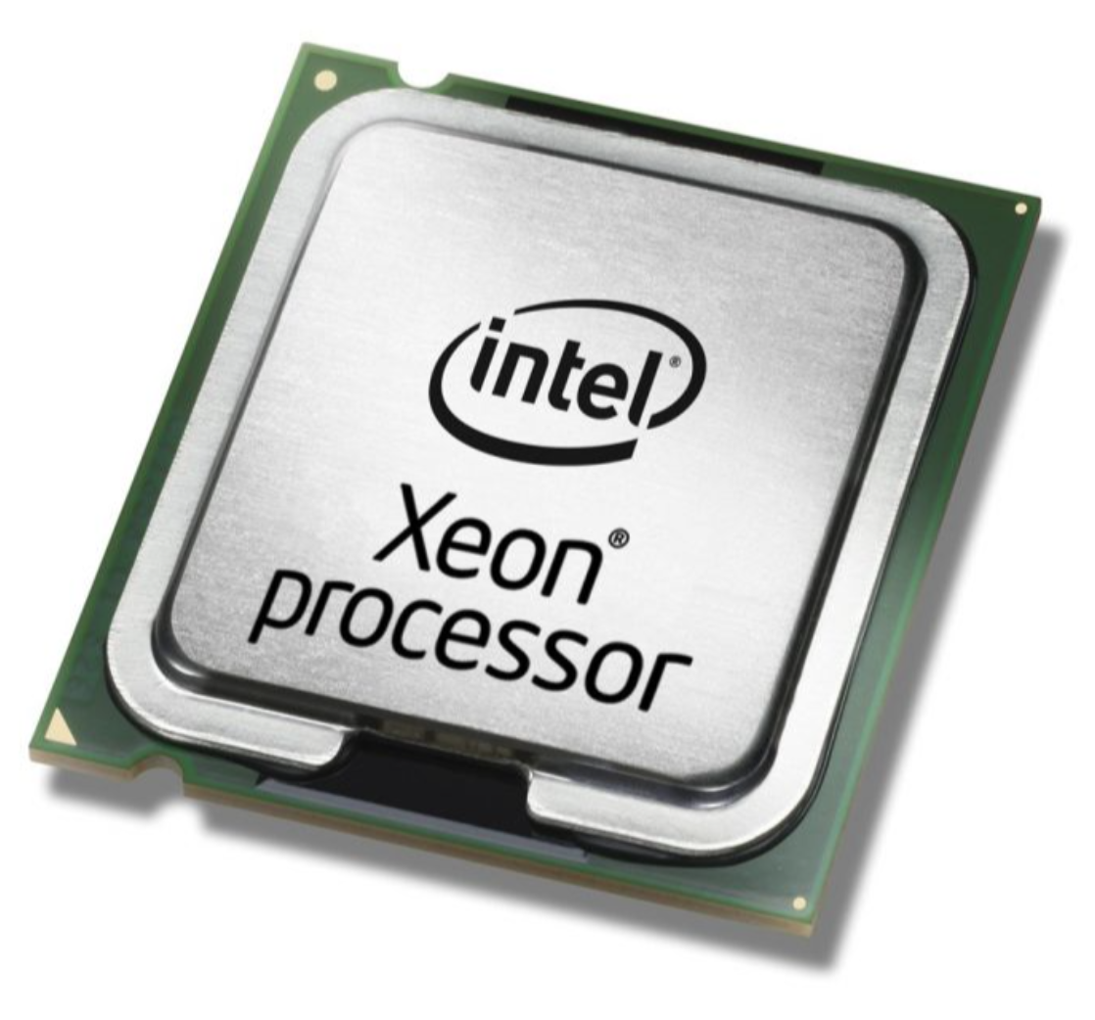
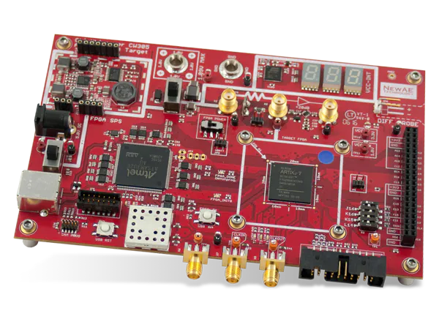
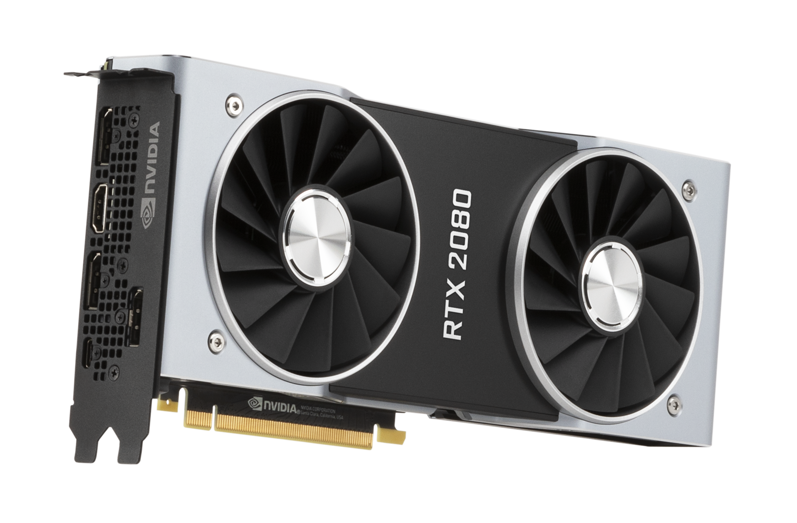
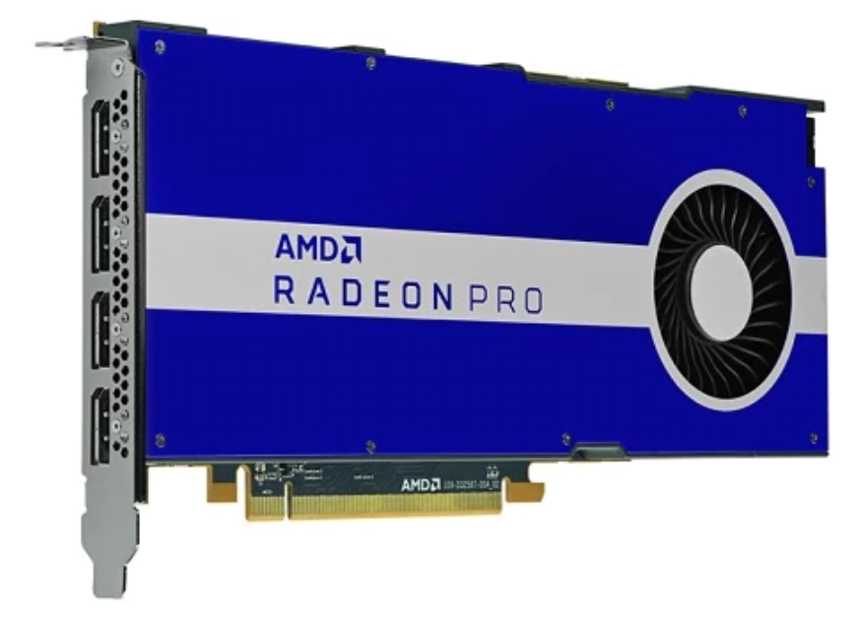
But NVIDIA GPU may be not
Software
Hardware
Notes:
But what about hardware that supports those languages. Natively, Cuda source code can only be executed on Nvidia GPU, and If we're discussing the portion of NVIDIA GPUs in the overall landscape of computing hardware, it is way less prevalent compared to how many cuda source code there are available in this community. In other words, there are simply so many other hardwares that we can utilize if we can run cuda source code on them.

Slide 6
Motivation
Software
Hardware
Notes:
So that was the biggest motivation of our CuPBoP project, which was to make CUDA source code executable in other HW platforms so that users with different HW can make use of more mature cuda community.

Slide 7
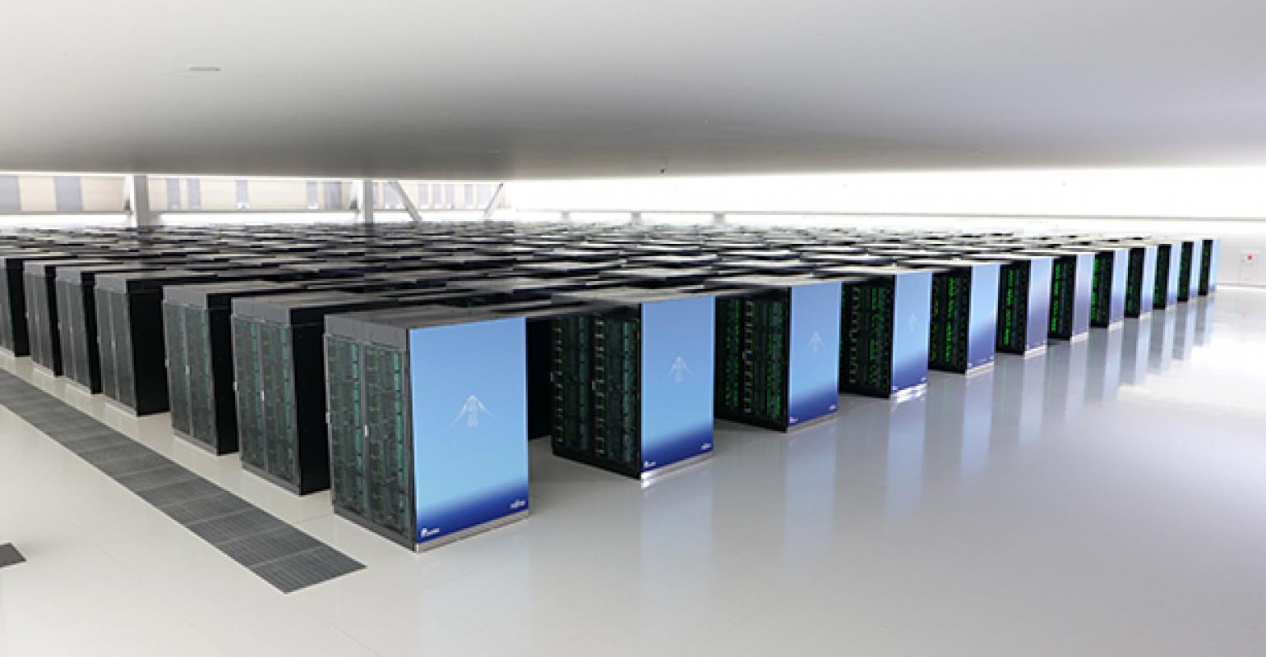

If CUDA can be executed in non-NVIDIA devices...
Other hardware vendors can benefit from the CUDA eco-system;
Allow Single-Kernel-Multiple-Device on heterogeneous system;
No need to migrate CUDA implementations;
…..
Notes:
If Cuda source code can run on multiple HW platforms,
This will benefit Software vendors by making them keep only one CUDA source if they’re targeting multiple HWs
In addition, Hardware vendors who have not previously enjoyed advantages from the CUDA community can now benefit from the CUDA ecosystem.

Slide 8
Related Works
Notes:
Several other projects aim to enable the execution of CUDA source code on non-NVIDIA devices. And These projects including CuPBoP, inevitably share a common process: translating CUDA code to make it compatible with non-NVIDIA hardware. However, methods and level of this translation vary significantly. In the following slides, I will cover at what level each project did the translation to make it executable on non-Nvidia devices, and explain pros and cons for each approach.

Slide 9
CUDA compilation process
CUDA program
host code
LLVM IR
FAT Binary
kernel code
NVVM IR
PTX Assembly
Front-end Compilation
(Clang)
NVPTX
Codegen
Notes:
But first, to provide you with a clearer understanding, I've included a diagram depicting an example of CUDA source code compilation pipeline for NVIDIA GPUs. Within the CUDA source code, we have both host and kernel code. The Clang front-end compiler generates LLVM IR and NVVM IR for the host and device components, respectively. And then, PTX code generation produces PTX assembly code for the device, and the final binary links all of these components together to execute in a heterogeneous system

Slide 10
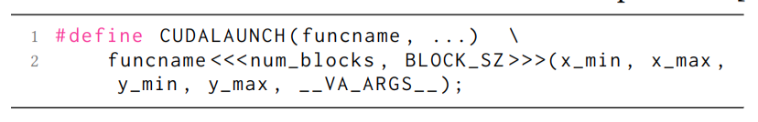
CUDA compilation process
Source to source translation
Pros:
Lightweight, easy to debug and maintain
Cons:
CUDA is based on C++, the grammar is too complicated to be fully covered
Highly depends on the similarity between CUDA and target languages
DPCT, HIPIFY
CUDA program
host code
LLVM IR
FAT Binary
kernel code
NVVM IR
PTX Assembly
Front-end Compilation
(Clang)
NVPTX
Codegen
Notes:
The first approach to make CUDA source code compatible with non-NVIDIA devices involves translating the source code itself. Examples of this approach include DPC++ and HIPIFY. DPC++ translates CUDA code into SYCL, while HIPIFY translates it into HIP, enabling it to run on their respective hardware platforms.
One of the advantages of this approach is that it simplifies debugging, as it deals exclusively with the source code. However, there is a downside: not every CUDA function maps directly to the target language.
Given Cudalaunch function is one example of them, because it’s invoked implicitly when user put kernel launch syntax in their source code. So this function is not visible in the source code level.
And therefore, the outcome largely depends on the specific target language the code is translated to. Given that CUDA is grounded in complex C++ grammar, there is a possibility that these translators may misinterpret the original CUDA code's intent.
DPC++ : Translate Cuda Src code to Sycl
HIPIFY: Translate Cuda Src to HIP

Slide 11
CUDA compilation process
Reverse Engineering
Pros:
No need to re-compile CUDA programs;
Cons:
No official open-sourced PTX parser, hard to maintain and update with latest CUDA.
Ocelot
CUDA program
host code
LLVM IR
FAT Binary
kernel code
NVVM IR
PTX Assembly
Front-end Compilation
(Clang)
NVPTX
Codegen
Notes:
The second approach involves reverse engineering. In this method, PTX assembly code is translated to enable execution on different types of devices. Notably, this approach doesn't impact any of the front-end compilation processes. and that means users are not required to recompile the CUDA source code to make it compatible with other devices.
However, there's a challenge with this approach. Since there is no official PTX parser provided by Nvidia, these translators need to be continually updated whenever Nvidia makes changes to their compilation pipeline.

Slide 12
CUDA compilation process
Support CUDA migration on LLVM/NVVM IR level
Pros:
No need to handle complicated CUDA grammar.
NVIDIA teams maintain the Clang-CUDA compilation, always up-to-date.
Based on LLVM, which is fully open-sourced.
CuPBoP
CUDA program
host code
LLVM IR
FAT Binary
kernel code
NVVM IR
PTX Assembly
Front-end Compilation
(Clang)
NVPTX
Codegen
Notes:
The final approach is our project, CuPBoP.
CuPBoP stands out from previous approaches by conducting all necessary translations at the Intermediate Representation (IR) level. Similar to reverse-engineering method, one of the significant advantages of this method is that it leverages the Clang front-end compiler, which is maintained by Nvidia, to generate the IR. and This eliminates concerns related to complex CUDA grammar. Furthermore, the generated LLVM IR code is fully open-sourced, eliminating the need for any reverse-engineering in the translation process.

Slide 13
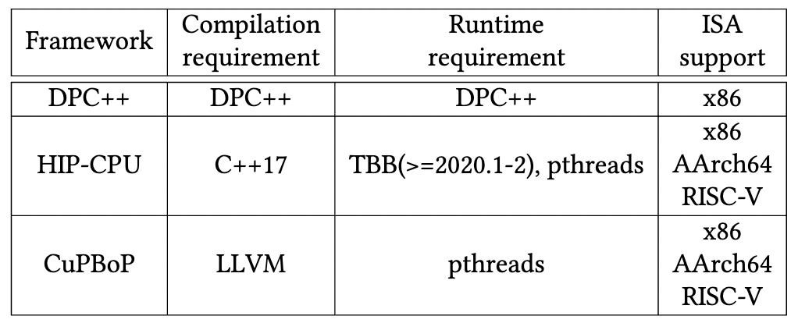
Supported Hardware backend
CuPBoP can execute CUDA on x86, AArch64, and RISC-V backends
Notes:
Here’s a summary of the dependencies and supported ISAs for each framework. Currently, CuPBoP offers support for x86, AMD GPUs, and Vortex.

Slide 14
CuPBoP Framework
Notes:
Building upon our previous discussion of CuPBoP's and high-level overview, let's cover each component inside CuPBoP framework.

Slide 15
CuPBoP framework
CUDA program
kernel code
NVVM IR
Translated NVVM IR
Kernel
Executable
Executable file
host code
LLVM IR
Translated
LLVM IR
Host
Executable
Kernel Wrapper
CuPBoP Runtime library
Vortex Kernel
Library
Vortex Runtime
Front-end
Compilation
(Clang)
CuPBoP
Compilation
Transformations
Backend
Compilation
Link
Process
Notes:
The figure you see illustrates a concise overview of the process. The overall approach is similar to running OpenCL on Vortex. However, instead of using on PoCL, we leverage the combined power of the Clang front-end compiler and the CuPBoP translator to perform the necessary compilation and translation tasks.

Slide 16
CuPBoP framework
CUDA program
kernel code
NVVM IR
Translated NVVM IR
Kernel
Executable
Executable file
host code
LLVM IR
Translated
LLVM IR
Host
Executable
Kernel Wrapper
CuPBoP Runtime library
Vortex Kernel
Library
Vortex Runtime
1
Front-end
Compilation
(Clang)
Notes:
Let's break down the process step by step. Just as when compiling for NVIDIA GPUs, the Clang front-end compiler generates LLVM IR and NVVM IR for both the host and kernel source code components.

Slide 17
CuPBoP framework
CUDA program
kernel code
NVVM IR
Translated NVVM IR
Kernel
Executable
Executable file
host code
LLVM IR
Translated
LLVM IR
Host
Executable
Kernel Wrapper
CuPBoP Runtime library
Vortex Kernel Library
vx_spawn_tasks
…
Vortex Runtime
2
CuPBoP
Compilation
Transformations
Notes:
Now, moving on to the second step, CuPBoP's compilation translator comes into play. In this crucial phase, CuPBoP handles all the necessary compilation changes. This includes mapping different types of defined cuda variables and collapsing the CUDA threads, which I'll cover in later slides.
Additionally, as part of this process, CuPBoP creates a 'kernel_wrapper.' , which is instrumental in launching the kernel within the Vortex environment, utilizing Vortex kernel library functions

Slide 18
CuPBoP framework
CUDA program
kernel code
NVVM IR
Translated NVVM IR
Kernel
Executable
Executable file
host code
LLVM IR
Translated
LLVM IR
Host
Executable
Kernel Wrapper
CuPBoP Runtime library
Vortex Kernel
Library
Vortex Runtime
3
Backend
Compilation
Notes:
Once all the IRs and required files are obtained, our backend compiler takes charge. In this step, it assembles the host and kernel executable files, complete with the Vortex-specific Instruction Set Architecture (ISA) (보강 필요)

Slide 19
CuPBoP framework
CUDA program
kernel code
NVVM IR
Translated NVVM IR
Kernel
Executable
Executable file
host code
LLVM IR
Translated
LLVM IR
Host
Executable
Kernel Wrapper
CuPBoP Runtime library
Vortex Kernel
Library
Vortex Runtime
4
Link
Process
Notes:
To bring it all together, we link these two executable files with the CuPBoP runtime library, which will be covered in the next slides. In addition, since CuPBoP runtime uses vortex runtime functions, we also link the Vortex runtime in this phase, ensuring a smooth execution of the file on Vortex.

Slide 20
CuPBoP framework
CUDA program
kernel code
NVVM IR
Translated NVVM IR
Kernel
Executable
Executable file
host code
LLVM IR
Translated
LLVM IR
Host
Executable
Kernel Wrapper
CuPBoP Runtime library
Vortex Kernel
Library
Vortex Runtime
Front-end
Compilation
(Clang)
CuPBoP
Compilation
Transformations
Backend
Compilation
Link
Process
Notes:
So that was the rough overview of the comprehensive pipeline. During this procsss, CuPBoP takes two pivotal roles. The first role involves IR translation, a fundamental aspect of our processs. The second role is to provide runtime library. In the following slides, I will provide a brief overview of each, with examples.

Slide 21
CuPBoP framework
CUDA program
kernel code
NVVM IR
Translated NVVM IR
Kernel
Executable
Executable file
host code
LLVM IR
Translated
LLVM IR
Host
Executable
Kernel Wrapper
CuPBoP Runtime library
Vortex Kernel
Library
Vortex Runtime
Implement CUDA APIs for non-NVIDIA devices
Front-end
Compilation
(Clang)
CuPBoP
Compilation
Transformations
Backend
Compilation
Link
Process
Notes:
Let's begin by exploring the CuPBoP runtime library, which is to implement CUDA APIs for non-NVIDIA devices. As an example,

Slide 22
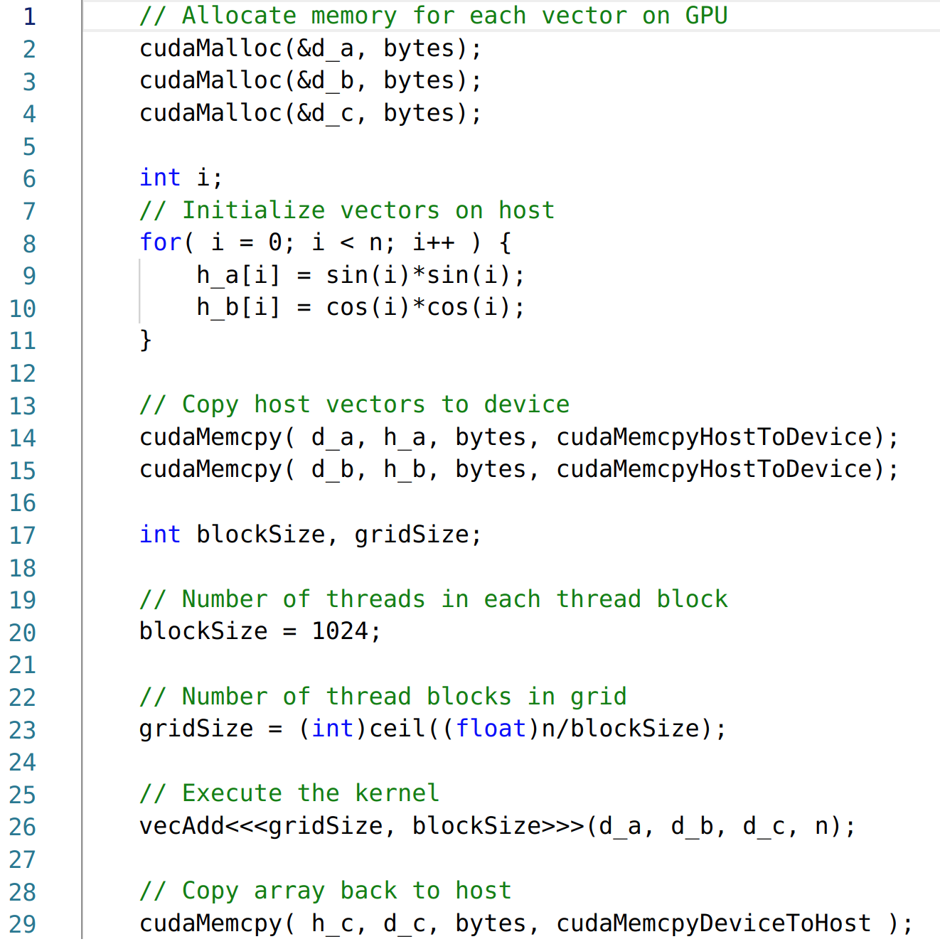
Case study: CUDA Runtime Functions
How should we handle CUDA Runtime functions?
Notes:
Here is a simple code snipset of host side in CUDA source code. As you can see, this code contains CUDA-specific functions, such as 'cudamemcpy' and 'cudamalloc.' During execution, these functions are going to be linked to NVIDIA's CUDA runtime functions.

Slide 23
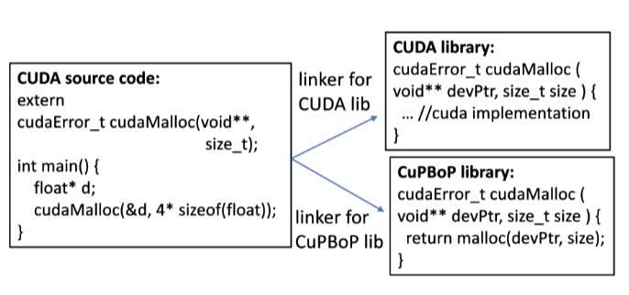
CuPBoP Runtime (CUDA API Implementation)
Vortex Runtime
…
vx_mem_alloc(…)
…
By changing the link path, CUDA code can be executed on Vortex without modifications.
To support a new CUDA API, the developers only need to implement the new API in the library.
Notes:
To make these functions compatible with non-NVIDIA devices, CuPBoP provides a runtime functions with the same function signature as the original runtime functions. For instance, to execute the 'cudamalloc' function on Vortex, we integrate the Vortex runtime library functions that were introduced earlier by Shinnyeong into the 'cudamalloc' function within CuPBoP's runtime library to do a memory allocation in vortex.
And CuPBoP runtime function library will get linked to the binary when it gets. This linkage process enables the binary to run on different hardware configurations without changing the form of the passed functions.

Slide 24
CuPBoP framework
CUDA program
kernel code
NVVM IR
Translated NVVM IR
Kernel
Executable
Executable file
host code
LLVM IR
Translated
LLVM IR
Host
Executable
Kernel Wrapper
CuPBoP Runtime library
Vortex Kernel
Library
Vortex Runtime
Front-end
Compilation
(Clang)
CuPBoP
Compilation
Transformations
Backend
Compilation
Link
Process
Notes:
Now, let's shift our focus to the second major role of CuPBoP, which is during IR translation. Throughout this phase, numerous changes are applied to the original IR code to make it executable on Vortex. But I’ll introduce one of them as an example.

Slide 25
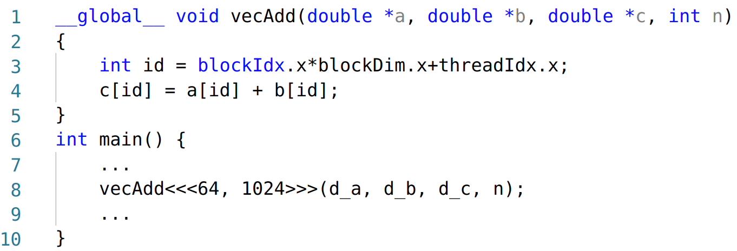
CuPBoP compilation
When the targeted architecture is significantly different from NVIDIA GPU...
There are 64K CUDA threads, much less than the number of active threads in Vortex.
The workload for each thread is too lightweight for each Vortex Thread.
Notes:
Let's consider a simple vector addition CUDA function. With 64 CUDA blocks, containing 1024 threads each, this sums up to 64K CUDA threads that need to be executed. This design aligns well with NVIDIA GPUs, which can efficiently handle thousands of threads simultaneously.
However, the Vortex hardware has fewer active hardware threads available, and executing this workload as is, might prove inefficient for Vortex.
To address this challenge, CuPBoP draws inspiration from what PoCL does for OpenCL-Vortex. It collapses the CUDA threads during compilation translation to ensure more efficient execution on Vortex.
-----
NVIDIA GPUs can support executing more than 10000~ of GPU threads. While most CPUs have ~100 cores at most.

Slide 26
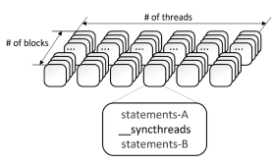
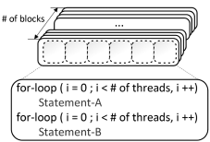
Mapping CUDA Threads to Vortex
Step1:
Analyze the Parallel Region[1]
(the regions between barriers that must be executed by all the threads before proceeding to the next region.)
[1] Jääskeläinen, Pekka, et al. "pocl: A performance-portable OpenCL implementation." International Journal of Parallel Programming 43.5 (2015): 752-785.
Notes:
To do that, again, similar to what PoCL did for work-group function, First, CuPBoP analyzes the parallel region of the program where it can execute parallely w/o any synchronization,

Slide 27
Mapping CUDA Threads to Vortex
Step1:
Analyze the Parallel Region[1]
(the regions between barriers that must be executed by all the threads before proceeding to the next region.)
Step2:
Wrap each Parallel Region with a single-layer for-loop.
[1] Jääskeläinen, Pekka, et al. "pocl: A performance-portable OpenCL implementation." International Journal of Parallel Programming 43.5 (2015): 752-785.
Notes:
Next, it wraps each parallel region with a single-layer for-loop. This way, each loop is dedicated to carrying out the same computation that was initially allocated for a CUDA block.

Slide 28
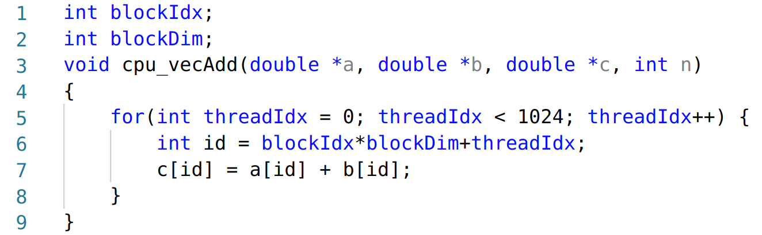
Mapping CUDA Kernel to Vortex
64K threads are required
The workload for each thread is too lightweight for each Vortex Thread for efficient execution
Compilation Transformations
Only 64 threads are required
The workloads are much heavier, which is more friendly to Vortex HW.
Notes:
So here I’m showing the example before-and-after comparison after this pass. While all these changes occur at the IR level, we present in source code for better understanding. As you can observe, the transformation reduces the initial 64,000 threads to a mere 64 threads. This streamlined approach can be significantly more efficiently mapped to Vortex hardware threads.

Slide 29
CuPBoP Compilation Passes Overview
Vortex
CUDA processing model
Thread
Block
Kernel execution instance
Vortex Warps
Thread
Warp
Core
Core
Core
Warp
Warp
Thread
Block
…
Thread
Thread
Kernel Instance
Generate Wrapper
for Kernel Launch
Support CUDA Shared, Const. Mem.
Thread Flat Collapsing
Handle Synchronizations
Optimization Passes
…
Notes:
Through this example, you can see how CuPBoP's IR translation process effectively maps each CUDA block to an individual Vortex hardware thread. However, it's important to note that this is just one aspect of the comprehensive IR translation carried out by CuPBoP.
In addition to this, CuPBoP undertakes various other passes, such as handling CUDA shared and constant memory, and modifying kernel arguments for launching kernels. All these combined efforts are geared toward making CUDA code fully executable for Vortex.

Slide 30
CuPBoP Tutorial
Notes:
Now that we learned how CUPBoP works, let me briefly introduce how we actually use this framework to execute Cuda source code on Vortex

Slide 31
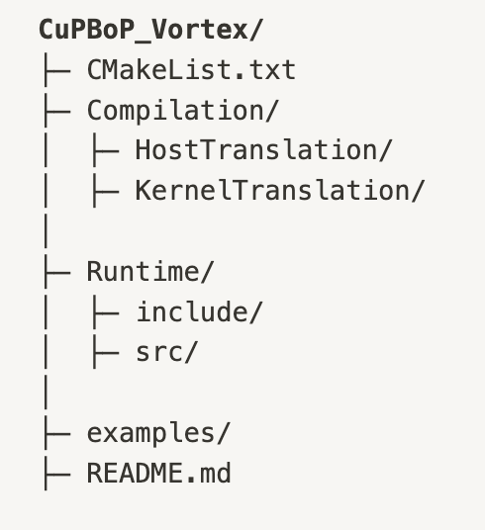
CuPBoP code structure
CuPBoP compilation part Most code is about LLVM transformations.
CuPBoP runtime library, implements two kinds of CUDA APIs:
Runtime function (e.g., cudaMalloc) : functions be executed on the host
Kernel function (e.g., nv_powf) : functions be executed on the device
Rodinia: Used for verification the correctness
Notes:
Here, I’m showing the code structure of CupBop. Since the framework doesn’t have lots of dependencies other than LLVM, it has pretty simple structure that can be splitted into compilation translation and runtime library as we covered in the CuPBOP overview. Here, Compilation part is in charge of most of LLVM transformations and CuPBoP runtime libraries will implement CUDA APIs so that It can be supported in Vortex.
And in the example folder, we have a subset of Rodinia benchmark suite to test the correctness of the framework.

Slide 32
How to Use CuPBoP
Step 0: Build CuPBoP
Requirements:
Linux system (verified: Ubuntu 18.04.3)
LLVM 10.0.0
CUDA toolkit (CuPBoP needs CUDA toolkit to compile the source programs to NVVM/LLVM IRs.)
CMake
Vortex (with its dependencies)
Notes:
So, Once you download this cupbop repo and after finishing the vortex environment setup, to build cupbop, basically
LLVM10 that is required for LLVM passes used and
cuda toolkit for initial compilation to LLVM and NVVM IR
are the only additional requirements to build cupbop.

Slide 33
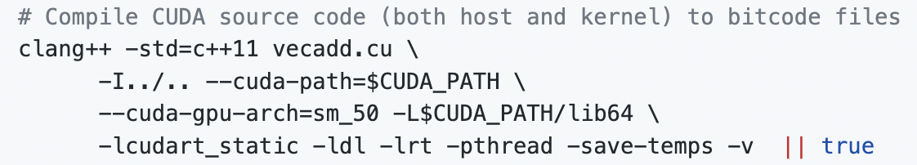
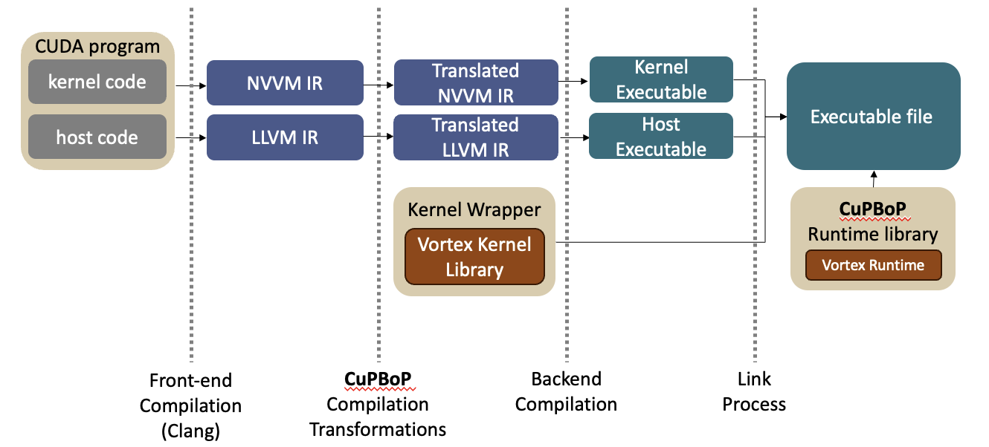
How to Use CuPBoP
Step 1: Compile CUDA programs to NVVM/LLVM IRs
This will generate two IR Files:
NVVM IR (Kernel)
vecadd-cuda-nvptx64-nvidia-cuda-sm_50.bc for
LLVM IR (Host)
vecadd-host-x86_64-unknown-linux-gnu.bc for
Notes:
Once you build cupbop and you have a cuda source code you want to run on Vortex. CuPBoP has a bash file that you can use for executing the source code if you don’t want to know the details of the compilation commands. But if you want to add your own feature for this framework, Here, I’m showing a snipset of the bash file showing the actual commandlines CuPBoP actually uses to run cuda source code on Vortex.
First, Clang front-end compiler will generate host and kernel IR files we want to translate in CupBop.

Slide 34
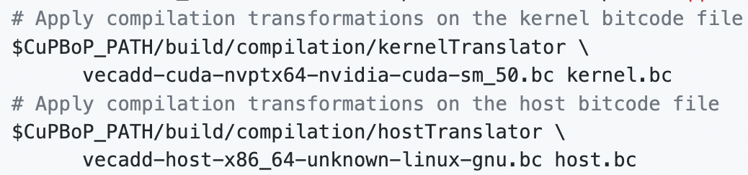
How to Use CuPBoP
Step 2: Apply transformations on both IRs. (CuPBoP compilation part)
CuBBoP will translate original IRs into
kernel.bc
host.bc
Notes:
Second, CUpBOp applies LLVM passes to translate the original LLVM IR to a new IR that can be supported in Vortex. After this, we’ll have a new LLVM IRs named kernel.bc and host.bc

Slide 35
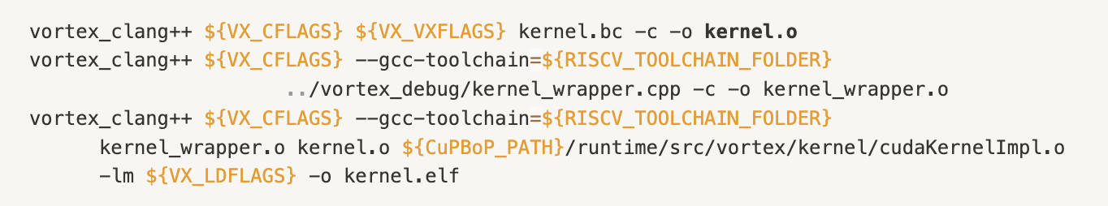
How to Use CuPBoP
Step 3: Back-end Compilation (Kernel)
Kernel
Kernel.bc is compiled for Vortex target.
Kernel Wrapper is compiled to be linked
Kernel functions, such as math library, are linked to create the kernel executable.
Notes:
Next step is the kernel back-end compilation. During this process, modified kernel IR will be compiled for vortex. And Kernel_wrapper, which was generated during previous step for kernel launch will be also compiled so that it can be linked in the later step. And Lastly, pre-compiled math library will be linked to generate one kernel objective file to be executed during runtime.

Slide 36
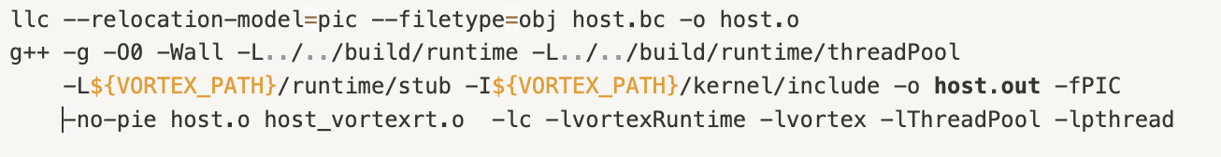
How to Use CuPBoP
Step 4: Back-end Compilation (Host)
Host
Host.bc is compiled for Vortex target.
CuPBoP Runtime library gets linked to generate final executable
Notes:
On the host side, translated host IR file will be compiled and then linked with both CuPBoP runtime library that I covered before, as well as vortex runtime to communicate with vortex device. And after this step, you’ll execute this host.out file to execute your cuda source code in your vortex heterogeneous system.

Slide 37
Evaluation (Rodinia)
Benchmark Name | feature | Support (64bit)
Gauss | Multi-kernel in series | O
BFS | - | O
NN | Math Library (sqrt) | O
NW | Shared Mem. | O
Srad_v2 | Shared Mem. + Syncthreads | O
Hotspot | Shared Mem. + Syncthreads | O
StreamCluster | Constant Mem. | O
Myocyte | - | O
Pathfinder | Shared Mem. + Syncthreads | O
LUD | Shared Mem. + Syncthreads | O
Btree | - | O
Backprop | __powf, __log2f | O
CFD | CudamemcpytoSymbol + Constant Memory | △
Huffman | Atomics | X
Notes:
To validate the availability and effectiveness of our translator, we conducted tests by attempting to execute CUDA examples from the Rodinia benchmark on the Vortex platform. It’s still on going process, but the results are promising. Our pipeline currently supports the majority of examples, specifically 13 out of 17 within the benchmark suite we have. For those few remaining unsupported examples, we are working on it to have more comprehensive support.

Slide 38
Q&A
Thanks for your time!
CuPBoP(x86) is an open-source project on Github.
(Vortex CuPBoP is coming soon!)
We welcome any kinds of contribution & feedback.
CuPBoP link: https://github.com/cupbop/CuPBoP
Related papers:
CuPBoP: CUDA for Parallelized and Broad-range Processors
Notes:
That was the end of my brief introduction of CuPBoP, Thank you for your attention. At the moment, only CuPBoP framework for the x86 platform is available as an open-source project. Feel free to explore it, and don’t hesitate to contact us if you’re interested CuPBoP vortex project. and we welcome any feedback you may have. If you have any questions, let us know.

Slide 39
Backup Slides

Slide 40
Experiments: benchmark coverage
 | DPC++ | HIP-CPU | CuPBoP
Rodinia-GPU | 56.5 | 56.5 | 73.9
Crystal | 0 | 76.9 | 100
CuPBoP achieves the highest coverage.

Slide 41
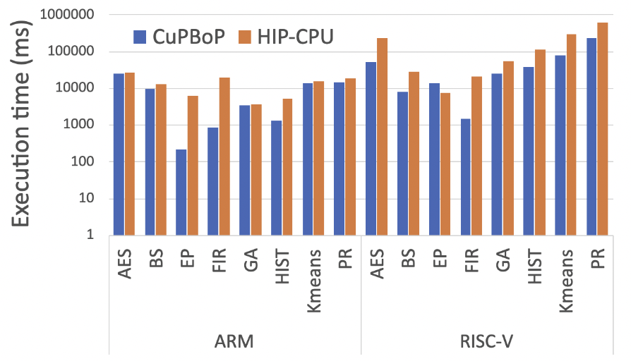
Experiments: performance
CuPBoP is 7.83x/4.25x times faster than HIP-CPU on AArch64/RISC-V.
CuPBoP is 2.28x faster than DPC++ and 3.36x faster than HIP-CPU on x86.

Slide 42
Future works
Optimize CuPBoP performance
Support CUDA libraries (e.g., cuBLAS, cuDNN...);
Can we execute CUDA programs on other devices faster than NVIDIA-GPUs?

